Slide 1
Fundamentals of Software Testing
COMP6100001 - Software engineering
Session 19
Kenny Jingga, S.Kom., M.T.

Slide 2
Session 19 – Fundamentals of Software Testing
Learning objectives
At the end of this session, students will be expected to be able to:
Understand the Objectives and Importance of Software Testing in Ensuring Software Quality
Describe Different Levels and Types of Software Testing
Apply Key Testing Techniques to Design and Execute Test Cases
Explore Test Planning, Defect Tracking, and Reporting Practices

Slide 3
Session 19 – Fundamentals of Software Testing
Content outline
Software Quality
Objectives and Importance of Software Testing
Levels of Testing: Unit, Integration, System, Acceptance
Types of Testing: Functional, Non-Functional, Regression, Performance, Usability
Testing Techniques: Black-Box, White-Box, Grey-Box
Test Planning and Design
Test Case Development and Execution
Defect Identification
Defect Reporting and Tracking

Slide 4

Software Quality
Secret of software quality

Slide 5

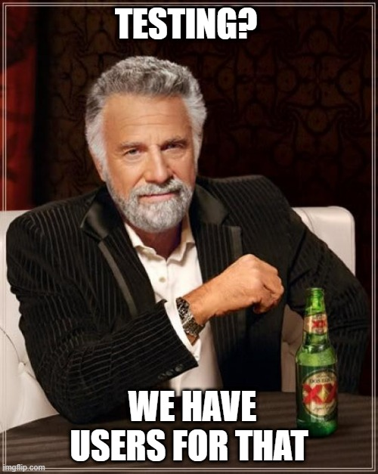
Software Quality
Internal vs External Quality
Internal Quality
External Quality
Is the code well structured?
Is the code understandable?
How well documented?
Does the software crash?
Does it meet the requirements?
Is the UI well designed?

Slide 6
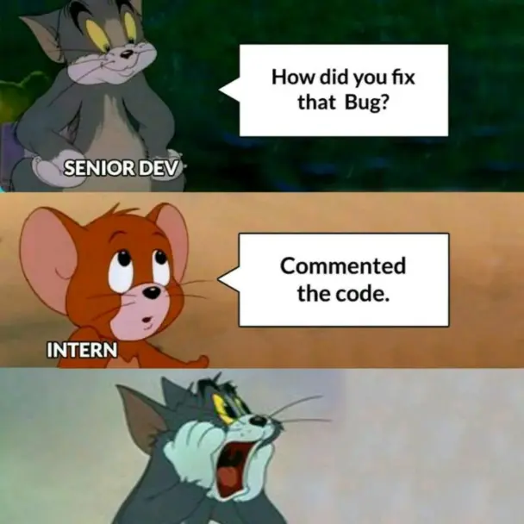
Software Quality
Testing
Assuring external quality

Slide 7
Objectives and Importance of Software Testing
Terminology
Failure:
  Deviation of the component or system from its expected delivery, service, or result
  Manifested inability of a system to perform required function
Fault / Defect:
  Flaw in component or system that can cause the component or system to fail to perform its required function
  A defect, if encountered during execution, may cause a failure of the component or system
Error / Mistake:
  A human action that produces an incorrect result
Bug
Testing: Attempt to trigger failures
Debugging: Attempt to find faults given a failure

Slide 8
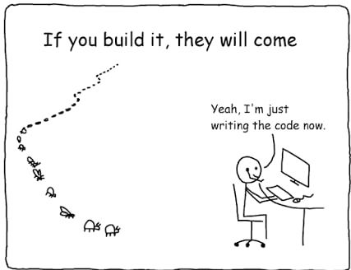
Objectives and Importance of Software Testing
Principles of Testing #1
Avoid the absence of defects fallacy
Testing shows the presence of defects
Testing does not show the absence of defects
“No test team can achieve 100% defect detection effectiveness”

Slide 9
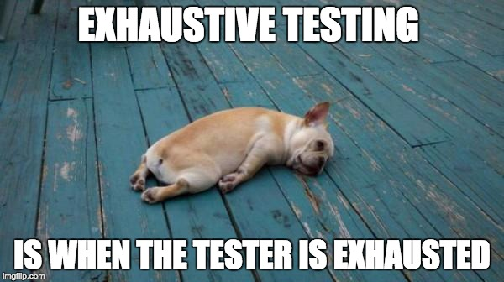
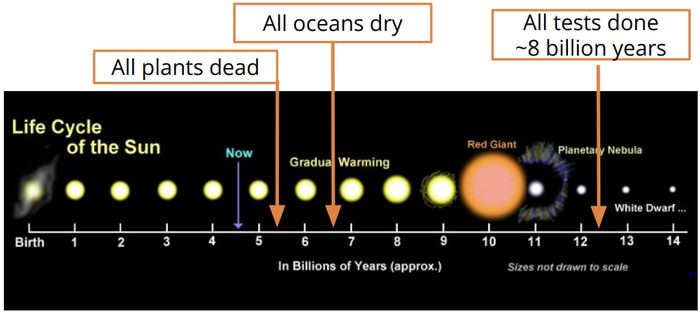
Objectives and Importance of Software Testing
Principles of Testing #2
Exhaustive testing is impossible
A simple function, 1 input, string, max. 26 lowercase characters + symbols (@,.,_,-)
Assume we can use 1 zettaFLOPS: 10²¹ tests per second

Slide 10
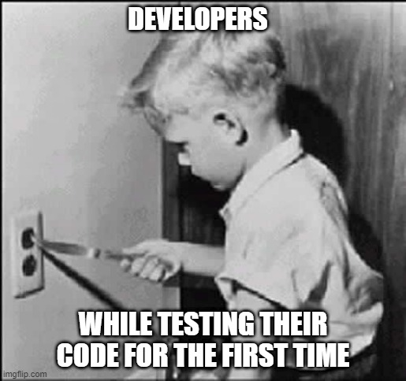
Objectives and Importance of Software Testing
Principles of Testing #3
Start testing early
To let tests guide design
To get feedback as early as possible
To find bugs when they are cheapest to fix
To find bugs when have caused least damage

Slide 11
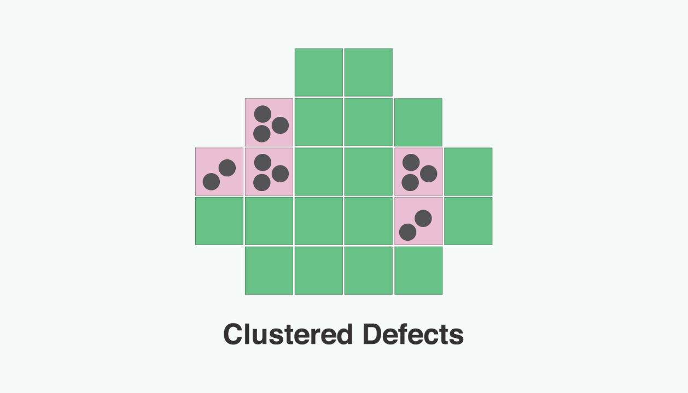
Objectives and Importance of Software Testing
Principles of Testing #4
Defects are usually clustered
“Hot” components requiring frequent change, bad habits, poor developers, tricky logic, business uncertainty, innovative, size, …
Use as heuristic to focus test effort

Slide 12
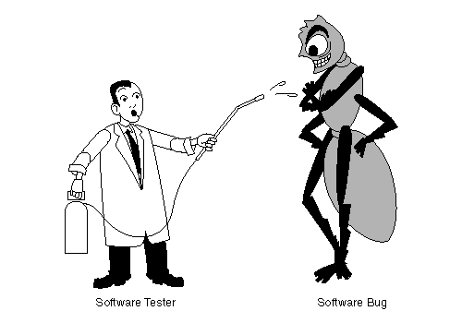
Objectives and Importance of Software Testing
Principles of Testing #5
The pesticide paradox
“Every method you use to prevent or find bugs leaves a residue of subtler bugs against which those methods are ineffectual.”
Re-running the same test suite again and again on a changing program gives a false sense of security
Variation in testing

Slide 13

Objectives and Importance of Software Testing
Principles of Testing #6
Testing is context-dependent
Depends on what kind of application that will be developed

Slide 14

Objectives and Importance of Software Testing
Principles of Testing #7
Verification is not validation
Verification
  Does the software system meet the requirements specifications?
  Are we building the software right?
Validation
  Does the software system meet the user's real needs?
  Are we building the right software?

Slide 15
Objectives and Importance of Software Testing
Primary objectives of Testing
Defect Identification: Detect and eliminate errors in software to ensure reliability.
Quality Assurance: Confirm the software meets specified requirements and expectations.
Verification and Validation: Ensure that the product is both built correctly (verification) and meets user needs (validation).
Risk Mitigation: Reduce risks by identifying and addressing issues early, which can prevent costly future errors.

Slide 16
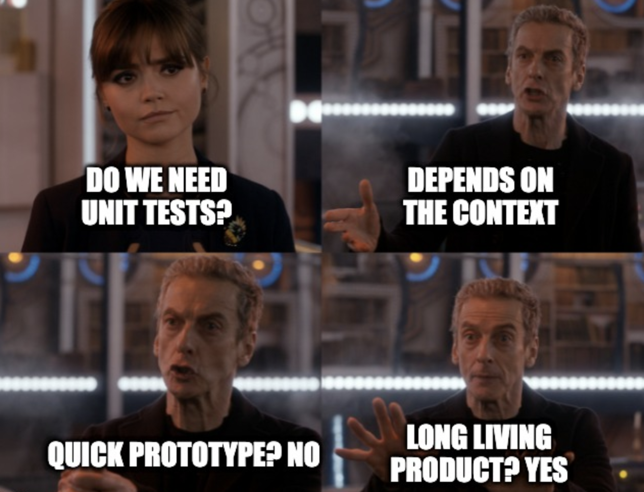
LEVELS of Testing
Unit Testing
Focuses on individual components or functions.
Ensures that each component performs as expected in isolation.
Example: Testing a login function independently of other components.

Slide 17
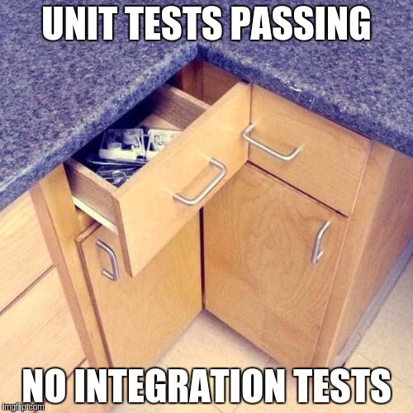
LEVELS of Testing
Integration Testing
Tests interactions between integrated components.
Ensures modules work together as expected.
Example: Testing that the login feature successfully retrieves data from a database.

Slide 18
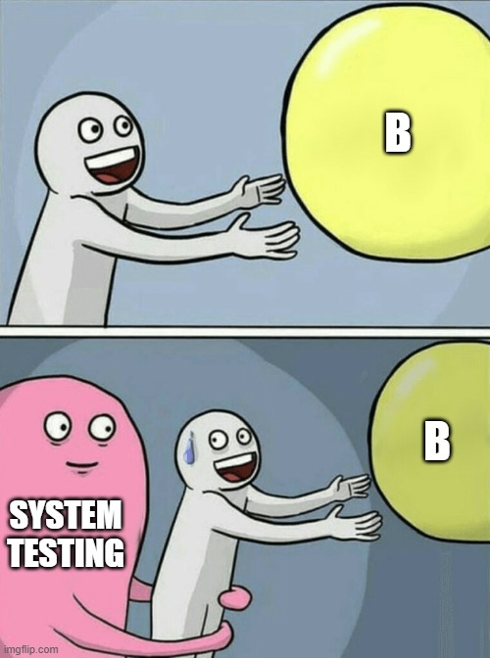
LEVELS of Testing
System Testing
Examines the complete, integrated system.
Validates that the software meets specified requirements.
Example: Testing all modules of an e-commerce app to ensure smooth purchasing flow.

Slide 19
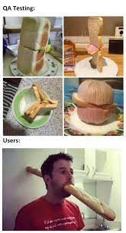
LEVELS of Testing
Acceptance Testing
Conducted from the end-user perspective to ensure the software meets their needs.
Often involves both alpha (internal) and beta (external) testing.
Example: Users test a social media app’s features in a real-world setting.

Slide 20
Types of Testing
Functional, Non-Functional, Regression, Performance, Usability
Functional Testing:
  Validates that software functions as specified in requirements.
  Focuses on output correctness, feature interactions, and user workflows.
  Example: Ensuring a “submit” button routes correctly to the next page.
Non-Functional Testing:
  Assesses system attributes like performance, security, and usability.
  Example: Testing how quickly a page loads under high user traffic.
Regression Testing:
  Ensures new code changes do not negatively impact existing functionality.
  Example: After updating the login feature, test all related workflows.
Performance Testing:
  Evaluates system responsiveness and stability under varying conditions.
  Example: Testing website load time with thousands of concurrent users.
Usability Testing:
  Measures how effectively users can navigate and interact with the software.
  Example: Testing navigation flow in a new app to ensure intuitiveness.

Slide 21
Testing Techniques
Black-Box, White-Box, Grey-Box
Black-Box Testing:
  Tests based on requirements and user expectations without knowledge of internal code.
  Useful for functional and usability testing.
  Example: Testing if form validation works without examining code.
White-Box Testing:
  Requires knowledge of the internal code structure, focusing on logic and data flow.
  Useful for unit and integration testing.
  Example: Testing specific functions within a login script.
Grey-Box Testing:
  Combines elements of black-box and white-box testing.
  Useful for testers with partial knowledge of code, often used for integration.
  Example: Testing with some knowledge of system interactions, such as APIs.

Slide 22
Test Planning and Design
What is Test Planning?
Test planning involves defining the testing scope, objectives, resources, schedule, and deliverables.
A solid test plan outlines clear goals, identifies risks, and assigns roles to ensure testing efficacy.
Steps in Test Planning
  Define testing scope and objectives.
  Develop test criteria for pass/fail conditions.
  Allocate resources and schedule.
  Identify potential risks and mitigation strategies.
Designing Effective Tests
  Use structured test cases to ensure clarity and reusability.
  Incorporate edge cases to address rare but possible scenarios.
Example: For an online banking system, test cases cover login, transfer, logout, and error handling.

Slide 23
Test Planning and Design
Test Design Techniques
Opportunistic / Exploratory Testing: Add some unit tests, without much planning
Specification-based Testing (“Black-box”): Derive test cases from specifications:
  Boundary value analysis
  Equivalence classes
  Combinatorial testing
  Random testing
Structural Testing (“White-box”): Derive test cases to cover implementation paths
  Line coverage, branch coverage

Slide 24
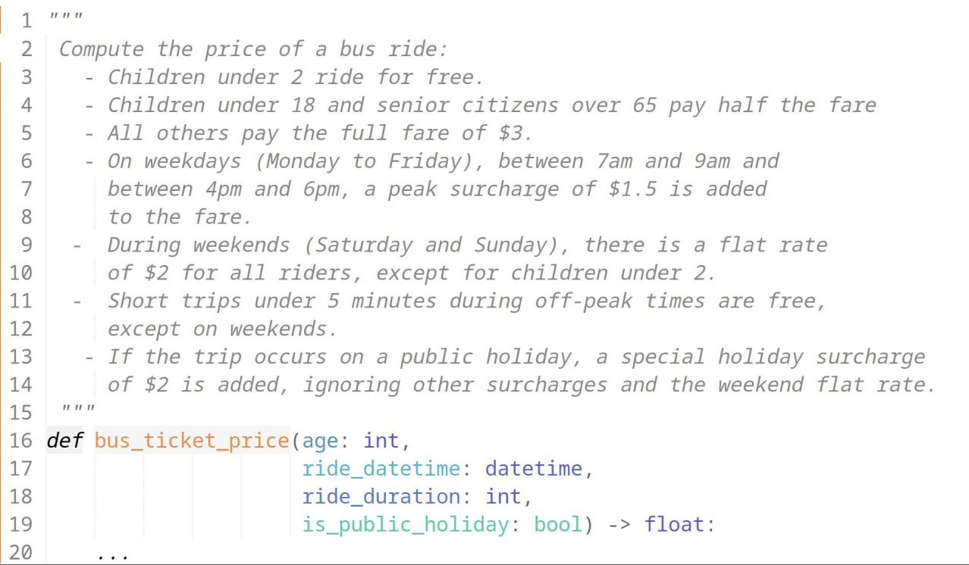
Test Planning and Design
Example Case

Slide 25
Test Planning and Design
Black-box: Exhaustive testing?
Idea: Try all values!
  age: int (2 - 117) years
  datetime: DateTime (hh:mm + M/D/Y)
  rideTime: int (in minutes, 1 - 2 Hours)
  is_public_holiday: bool (2 values)
  116 x 1440 (minutes per day) x 1826 (days in the next 5 years) x 120 (ride time) x 2
  ~ 72 Billion test cases

Slide 26
Test Planning and Design
Black-box: Exhaustive testing?
Exhaustive testing is usually impractical – even for trivially small problem
Key problem: choosing test suite
  Small enough to finish in a useful amount of time
  Large enough to provide a useful amount of validation
  Alternative: Heuristics

Slide 27
Test Planning and Design
Black-box: Equivalence Partitioning
Divides input data into partitions where test cases are derived to cover each partition at least once.
Each partition should be treated similarly by the software, so only one test case per partition is needed.
Identify sets with same behavior (equivalence class)
Try one input from each set
Equivalence classes derived from specifications (e.g., cases, input ranges, error conditions, fault models)
Requires domain-knowledge

Slide 28
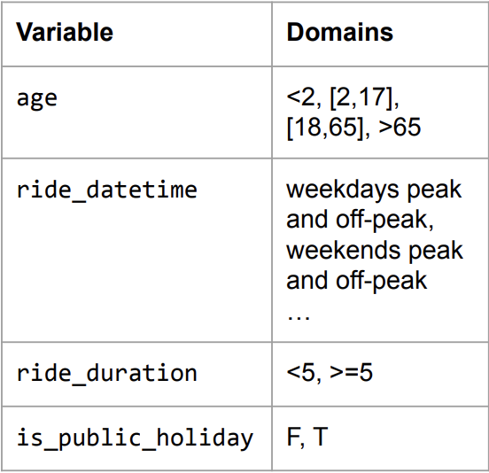
Test Planning and Design
Black-Box: Category-Partition Method
Identify the parameters
The domains of each parameter
  From the specs
  Not from the specs
Add constraints (minimize)
Remove invalid combinations
Reduce number of exceptional behaviors
Generate combinations

Slide 29
Test Planning and Design
Black-Box: Boundary-Value Analysis
Focuses on testing the boundaries of input ranges rather than the typical values.
Boundary values often reveal issues that average values do not.
Key Insight: Errors often occur at the boundaries of a variable value
For each variable, select:
  minimum,
  min+1,
  medium,
  max-1,
  maximum;
  possibly also invalid values min-1, max+1

Slide 30
Test Planning and Design
Black-Box: Pairwise Testing
Key Insight: some problems only occur as the result of an interaction between parameters/components
Examples of interactions:
  The bug occurs for senior citizens traveling on weekends (pairwise interaction)
  The bug occurs for senior citizens traveling on weekends during peak hours (3-way interaction)
  The bug occurs for adults traveling long trips during public holidays that are weekends. (4-way interaction)
Claim: Considering pairwise interactions finds about 50% to 90% of defects

Slide 31
Test Planning and Design
Other Black-box Testing
Decision Table Testing
  A structured way of representing complex business logic by listing conditions and actions in a table format. Each row represents a unique combination of inputs and expected outputs.
State Transition Testing
  Useful for systems with a finite number of states. It validates state changes in response to various events.
Use Case Testing
  Use case testing involves creating test cases based on user interactions with the system as defined in use case scenarios. It ensures that the system behaves as expected in different scenarios.
Error Guessing
  Test cases are created based on testers’ experience, knowledge of common errors, and areas that are likely to fail.

Slide 32
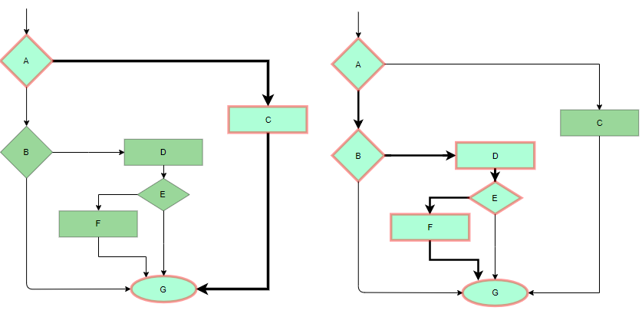
Test Planning and Design
White-boX: Statement Coverage
Ensures that every executable statement in the code is run at least once.
This is one of the simplest forms of white-box testing.

Slide 33
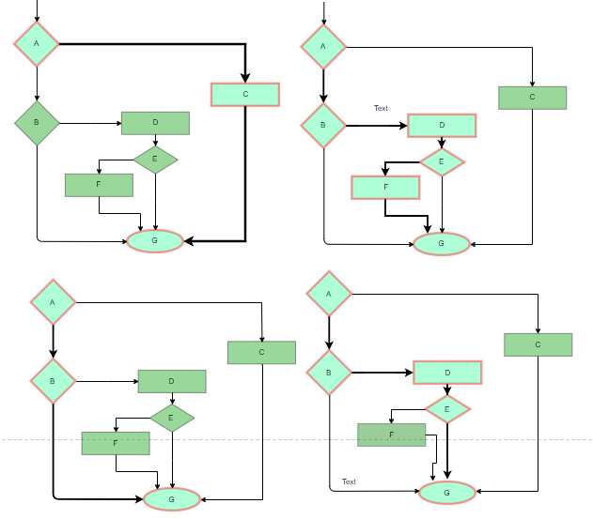
Test Planning and Design
White-boX: Branch Coverage
Ensures that each possible branch (true or false) from every decision point is executed at least once.
It helps uncover errors in conditional statements.

Slide 34
Test Planning and Design
White-boX: Condition Coverage (Predicate Coverage)
Tests each individual condition in a complex decision to ensure that all possible outcomes (true and false) for each condition are evaluated.
Test Cases:
  age = 20, has_license = True ➔ Eligible (both conditions true).
  age = 17, has_license = True ➔ Not eligible (age condition false).
  age = 20, has_license = False ➔ Not eligible (license condition false).
Goal: Test each condition independently within a decision to capture potential logical errors.
def check_eligibility(age, has_license):
if age >= 18 and has_license:
print("Eligible")
else:
print("Not eligible")

Slide 35
Test Planning and Design
White-boX: Basis Path Testing
In this technique, control flow graphs are made from code or flowchart and then Cyclomatic complexity is calculated which defines the number of independent paths so that the minimal number of test cases can be designed for each independent path.
Steps:
  Make the corresponding control flow graph
  Calculate the cyclomatic complexity
  Find the independent paths
  Design test cases corresponding to each independent path
V(G) = P + 1, where P is the number of predicate nodes in the flow graph
V(G) = E – N + 2, where E is the number of edges and N is the total number of nodes
V(G) = Number of non-overlapping regions in the graph

Slide 36
Test Case Development and Execution
Creating Test Cases
Test cases specify step-by-step actions to verify a specific functionality, expected outcomes, and conditions.
Components: Test ID, description, prerequisites, steps, expected results, and actual results.
Example: A test case for login might include steps for inputting username/password, expected success messages, and actions if incorrect input is given.

Slide 37
Test Case Development and Execution
Executing Test Cases
Executing test cases systematically to compare actual vs. expected outcomes.
Testers document outcomes, report issues, and classify defects based on severity.
Automated vs. Manual Execution
Manual Testing: For exploratory, usability, and ad-hoc testing.
Automated Testing: For repetitive, data-intensive testing that benefits from speed.

Slide 38

Defect Identification
Twitter’s Week Year Bug
ISO 8601 rule: The first week of the year is the week containing the first Thursday.
“So if January 1 falls on a Friday, it belongs to the last week of the previous year. If December 31 falls on a Wednesday, it belongs to week 01 of the following year.”
DateTimeFormatter.ofPattern("dd MMM YYYY").format(zonedDateTime)

Slide 39
Defect Identification
Could you have found them?
How often would those bugs trigger?
  Driver bug:
  What happens if you return from a driver with interrupts disabled?
  Consider: that’s one function
  …in a 2000 LOC file
  …in a module with 60,000 LOC
  …IN THE LINUX KERNEL
Some defects are very difficult to find via testing, inspection

Slide 40
Defect Identification
Could you have found them?
Are on uncommon or difficult-to-force execution paths. (vs testing)
Executing (or interpreting/otherwise analyzing) all paths concretely to find such defects is infeasible.
What we really want to do is check the entire possible state space of the program for particular properties.
What we CAN do is check an abstract state space of the program for particular properties.

Slide 41
Defect Identification
What is Static Analysis?
Systematic examination of an abstraction of program state space.
Does not execute code! (like code review)
Abstraction: produce a representation of a program that is simpler to analyze.
Results in fewer states to explore; makes difficult problems tractable.
Check if a particular property holds over the entire state space:
Liveness: “something good eventually happens.”
Safety: “this bad thing can’t ever happen.”
Compliance with mechanical design rules.

Slide 42
Defect Identification
Analyze the Python program statically (Yes/No/Maybe)
What are the set of data types taken by variable ‘u’ at any point in the program?
Can the variable ‘u’ be a negative number?
Will this function always return a value?
Can there ever be a division by zero?
Will the returned value ever contain a minus sign ‘-’?
def n2s(n: int, b: int):
if n <= 0: return ‘0’
r = ’’
while n > 0:
u=n%b
if u >= 10:
u = chr(ord('A') + u-10)
n = n // b
r = str(u) + r
return r

Slide 43
Defect Identification
What static Analysis can and cannot do
● Type-checking is well established
  ○ Set of data types taken by variables at any point
  ○ Can be used to prevent type errors (e.g. Java) or warn about potential type errors (e.g. Python)
● Checking for problematic patterns in syntax is easy and fast
  ○ Is there a comparison of two Java strings using `==`?
  ○ Is there an array access `a[i]` without an enclosing bounds check for `i`?
● Reasoning about termination is impossible in general
  ○ Halting problem
● Reasoning about exact values is hard, but conservative analysis via abstraction is possible
  ○ Is the bounds check before `a[i]` guaranteeing that `I` is within bounds?
  ○ Can the divisor ever take on a zero value?
  ○ Could the result of a function call be `42`?
  ○ Will this multi-threaded program give me a deterministic result?
  ○ Be prepared for “MAYBE”
● Verifying some advanced properties is possible but expensive
  ○ CI-based static analysis usually over-approximates conservatively

Slide 44
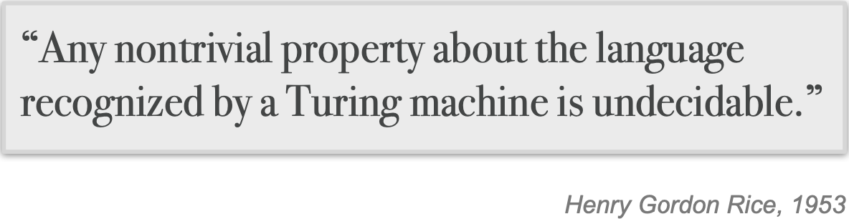
Defect Identification
The Bad News: Rice’s Theorem
Every static analysis is necessarily incomplete, unsound, undecidable, or a combination thereof

Slide 45
Defect Identification
Well Suited to Detecting certain defects
Security: Buffer overruns, improperly validated input...
Memory safety: Null dereference, uninitialized data...
Resource leaks: Memory, OS resources...
API Protocols: Device drivers; real time libraries; GUI frameworks
Exceptions: Arithmetic/library/user-defined
Encapsulation:
– Accessing internal data, calling private functions...
Data races:
– Two threads access the same data without synchronization

Slide 46
Defect Identification
Analyze the Python program Dynamically
What are the set of data types taken by variable ‘u’ at any point in the program?
Did the variable ‘u’ ever contain a negative number?
For how many iterations did the while loop execute?
Was there ever be a division by zero?
Did the returned value ever contain a minus sign ‘-’?
def n2s(n: int, b: int):
if n <= 0: return ‘0’
r = ’’
while n > 0:
u=n%b
if u >= 10:
u = chr(ord('A') + u-10)
n = n // b
r = str(u) + r
return r
print(n2s(12, 10))

Slide 47
Defect Identification
Dynamic Analysis reasons about program executions
● Tells you properties of the program that were definitely observed
  ○ Code coverage
  ○ Performance profiling
  ○ Type profiling
  ○ Testing
● In practice, implemented by program instrumentation
  ○ Think “Automated logging”
  ○ Slows down execution speed by a small amount

Slide 48
Defect Identification
Static Analysis vs Dynamic Analysis
Static Analysis
Requires only source code
Conservatively reasons about all possible inputs and program paths
Reported warnings may contain false positives
Can report all warnings of a particular class of problems
Advanced techniques like verification can prove certain complex properties, but rarely run in CI due to cost
Dynamic Analysis
Requires successful build + test inputs
Observes individual executions
Reported problems are real, as observed by a witness input
Can only report problems that are seen. Highly dependent on test inputs. Subject to false negatives
Advanced techniques like symbolic execution can prove certain complex properties, but rarely run in CI due to cost

Slide 49

Defect Identification
Tools for Static Analysis

Slide 50
Defect Identification
Static Analysis can be applied to all attributes
Find bugs
Refactor code
Keep your code stylish!
Identify code smells
Measure quality
Find usability and accessibility issues
Identify bottlenecks and improve performance

Slide 51
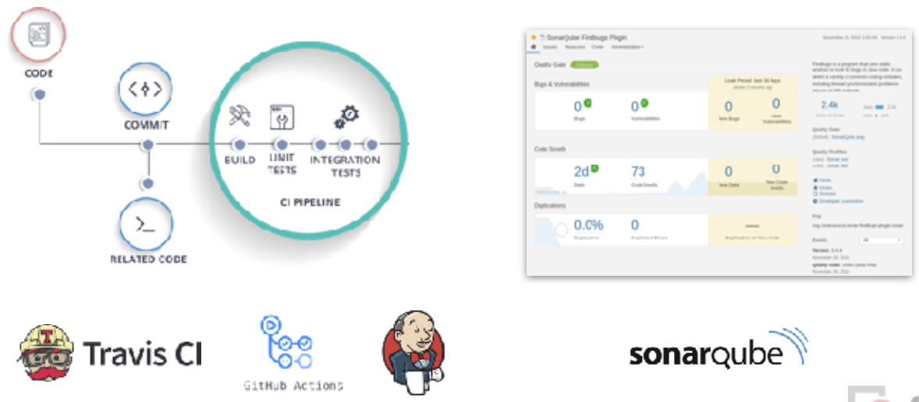
Defect Identification
Static analysis is a key part of continuous integration

Slide 52
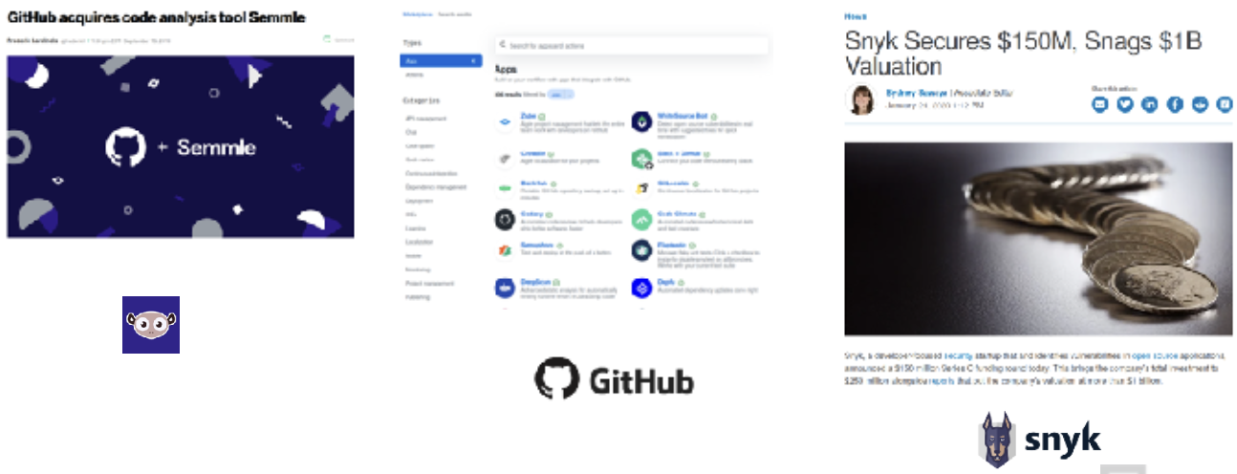
Defect Identification
Static analysis is a Growing industry

Slide 53
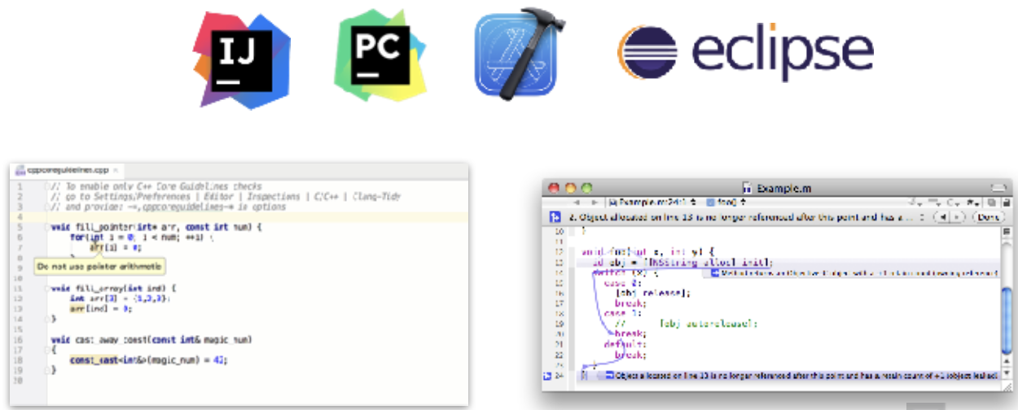
Defect Identification
Static analysis is also integrated into ides

Slide 54
Defect Identification
What makes a good static analysis tool?
Static analysis should be fast
  ○ Don’t hold up development velocity
  ○ This becomes more important as code scales
Static analysis should report few false positives
  ○ Otherwise developers will start to ignore warnings and alerts, and quality will decline
Static analysis should be continuous
  ○ Should be part of your continuous integration pipeline
  ○ Diff-based analysis is even better -- don’t analyse the entire codebase; just the changes
Static analysis should be informative
  ○ Messages that help the developer to quickly locate and address the issue
  ○ Ideally, it should suggest or automatically apply fixes

Slide 55
Defect Reporting and Tracking
Purpose of Defect Tracking
  Defect tracking enables systematic identification, analysis, and resolution of issues, enhancing transparency and communication in the testing process.
Defect Lifecycle
  Identification: Document the defect and assign priority.
  Resolution: Developers resolve the defect and perform retests.
  Closure: Verify the fix and close the defect if resolved.
Tools for Defect Tracking
  Examples: JIRA, Bugzilla, GitHub Issues.
  Tools help organize defects by severity, prioritize fixes, and provide status updates.
Sample Defect Report
  Include defect ID, title, description, steps to reproduce, environment, priority, and resolution.

Slide 56
References
Titus Winters, Tom Manshreck, and Hyrum Wright. (2020). Software Engineering at Google: Lesson Learned from Programming Over Time. 1st. O’Reilly Media. California. ISBN: 978-1492082798. Page 5-24.
Roger Pressman and Bruce Maxim. (2020). Software Engineering: A Practitioner's Approach. 9th E. McGraw- Hill. New York. ISBN: 9781259872976.
Beizer, B. (2020). Software Testing Techniques (3rd Edition). Dreamtech Press.

